Slide 1

DSLab 2020
The Data Science Lab Week 2
Data Science Lab – Spring 2020

Slide 2
Outline
Q&A
Reproducible Data Science
Data Science Collaboration tools
Git, git-lfs, gitlab
Docker
Conda & pip
Exercises week 2

Slide 3
Q&A week - 1
Spring 2020 - week #2

Slide 4
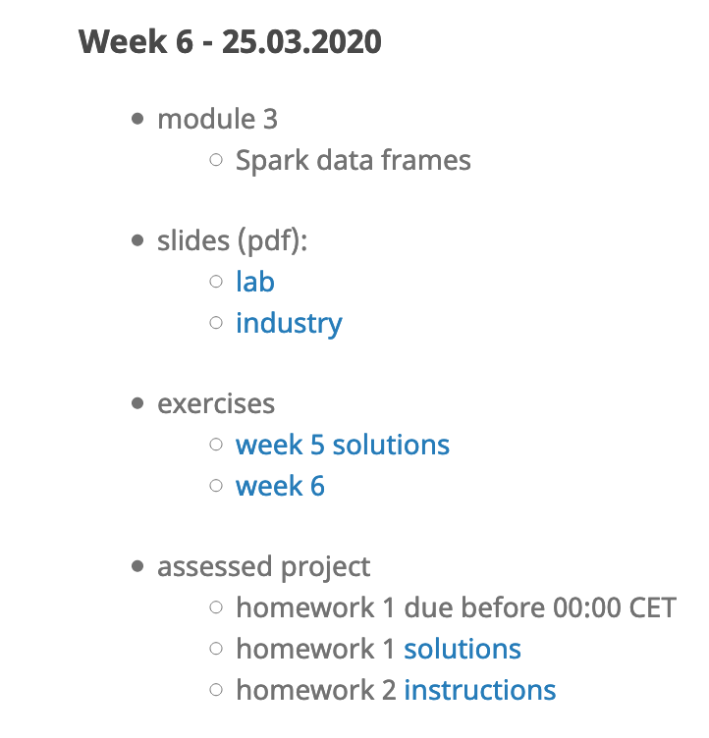
Q&A week - 1
e.g.
Class calendar https://epfl-dslab2020.github.io/
Presentations and exercises will be posted up to a week max before class
Exercise solutions will be posted on morning of next class
Homework instructions will be posted immediately before class
Homeworks are due two weeks later, at midnight before class
Homeworks solutions will be posted next morning after due date
Students work in groups of 3 to 4
Exceptionally, groups of 2 are allowed (talk to profs)
Quiz
How many students completed week 1’s exercise 1, .. exercise 2?
Solutions of exercises week 1
https://renku.iccluster.epfl.ch/projects/dslab2020/dslab-solutions-week-1/

Slide 5
Reproducible Data Science
Spring 2020 - week #2

Slide 6

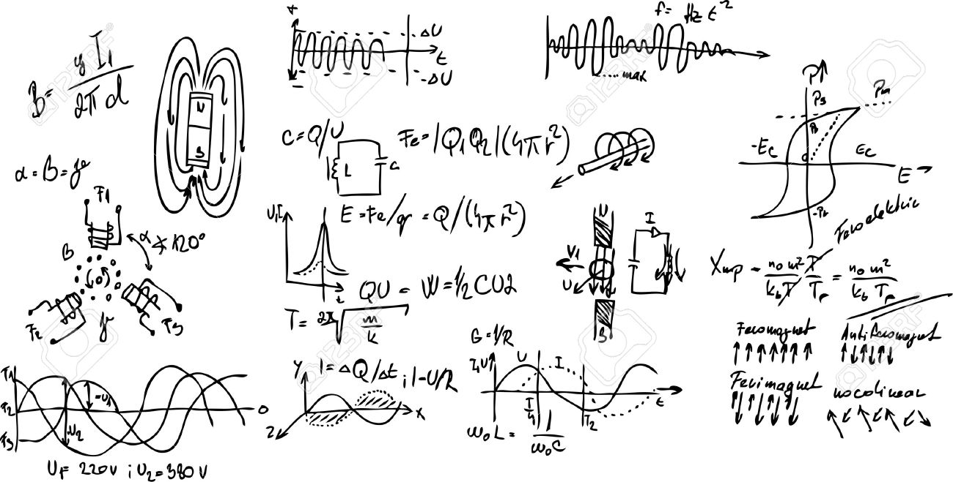
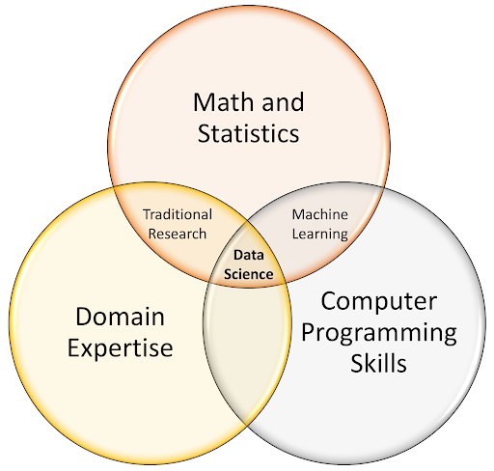
Practitioners of Data Science
ML/stats for real world data (anomalies, outliers, missing data, etc)
Hadoop, Spark, Kafka
Work with large scale data
Batch or streaming data
Hear about a number of concrete data science projects on which the Industry Team at SDSC works on with industry partners
awk –F, ‘{ a[$1]++} END { for(i in a) { print i,a[i] } } <(find . –name \*.\*sv –exec cat \{\} \;) | sort –k2,2 –n -r

Slide 7
Standard Process for Data Mining
Business Understanding
Data
Understanding
Data
Preparation
Modelling
Evaluation
Deployment
set business objectives
Produce project plan
Business success criteria
Collect and review data
Describe data
Explore data
Verify data quality
Select data
Clean data
Construct required data
Integrate data
Select modeling techniques
Generate test design
Build model
Assess model
Evaluate results
Review process
Decide next steps
Plan deployment
Plan monitoring and maintenance
Produce reports
Review project
[1] CRISP-DM https://www.sv-europe.com/crisp-dm-methodology/

Slide 8
Standard Process for Data Mining
Business Understanding
Data
Understanding
Data
Preparation
Modelling
Evaluation
Deployment
set business objectives
Produce project plan
Business success criteria
Collect and review data
Describe data
Explore data
Verify data quality
Select data
Clean data
Construct required data
Integrate data
Select modeling techniques
Generate test design
Build model
Assess model
Evaluate results
Review process
Decide next steps
Plan deployment
Plan monitoring and maintenance
Produce reports
Review project
awk –F, ‘{ a[$1]++} END { for(i in a) { print i,a[i] } } <(find . –name \*.\*sv –exec cat \{\} \;) | sort –k2,2 –n -r
?
Is it reproducible?
Can we trust it?
Can we reuse it?
How did we get here?

Slide 9
xkcd.com/1838

Slide 10
Reproducibility Crisis
Spring 2020 - week #2

Slide 11
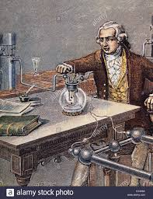
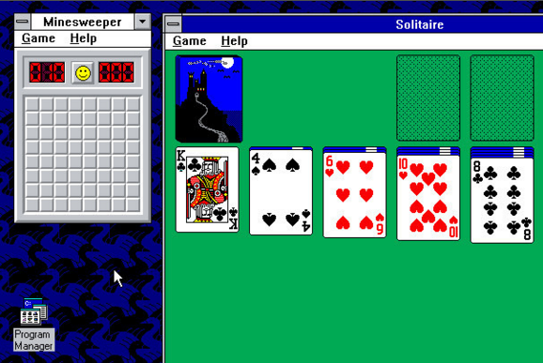

Slide 12

Guidelines
Researchers: include a clear, specific, and complete description of how the reported results were reached
Funding agencies and organizations: should consider investing in research and development of open-source, usable tools and infrastructure that support reproducibility
Journals: should consider ways to ensure computational reproducibility
The NSF: should take steps to facilitate the transparent sharing and availability of digital artifacts, such as data and code

Slide 13
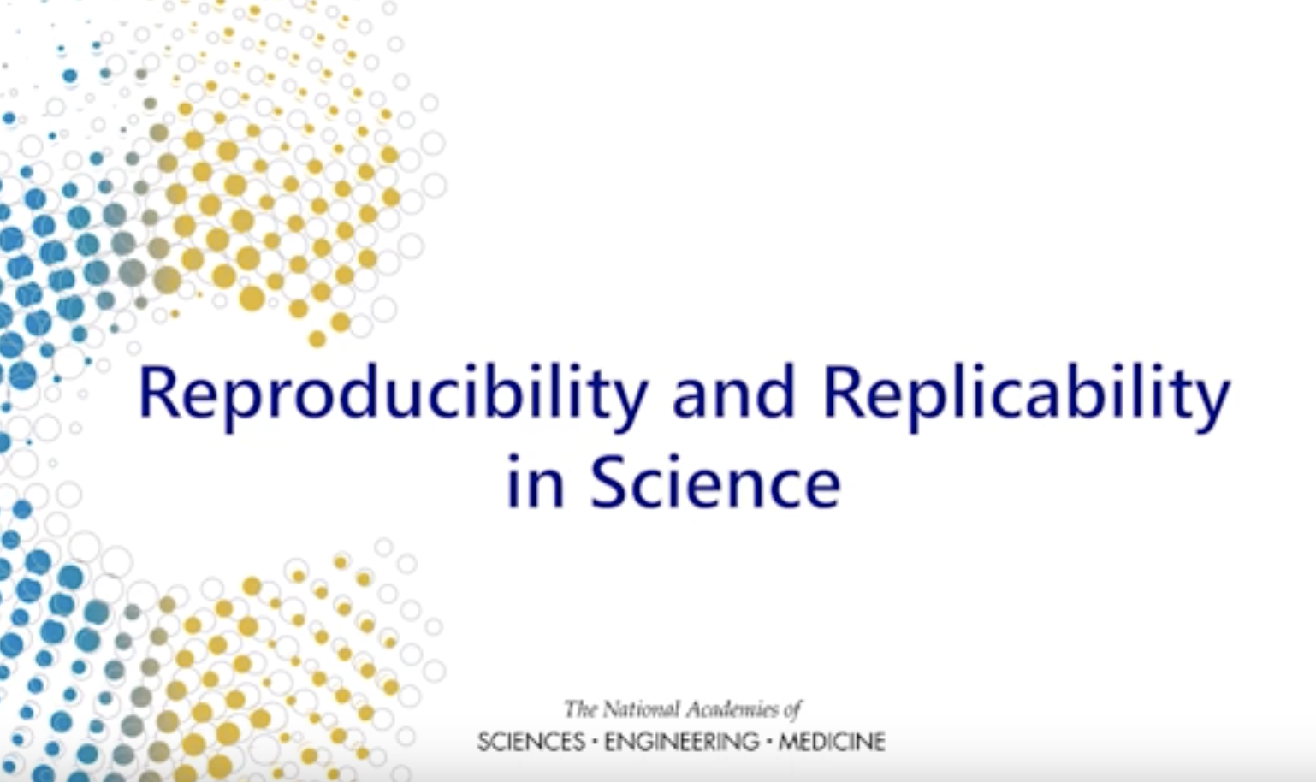
Guidelines
Source: NASEM

Slide 14
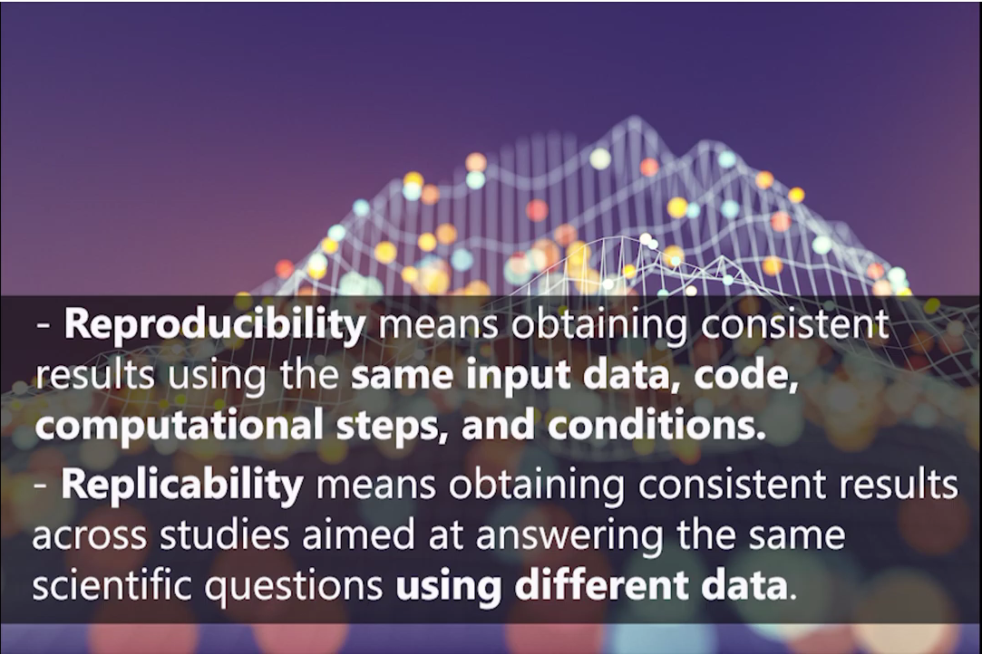

Reproducibility and Replicability in Data Science

Slide 15
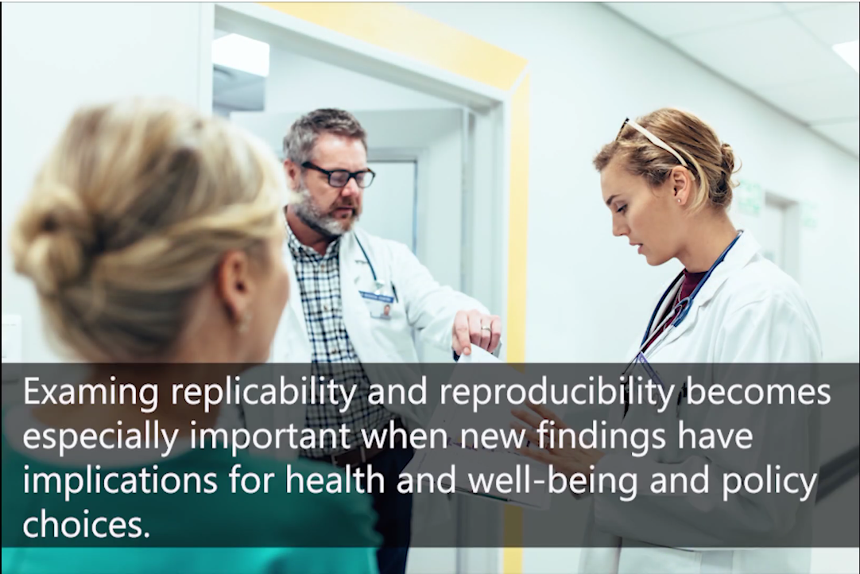
Reproducibility and Replicability in Data Science

Slide 16
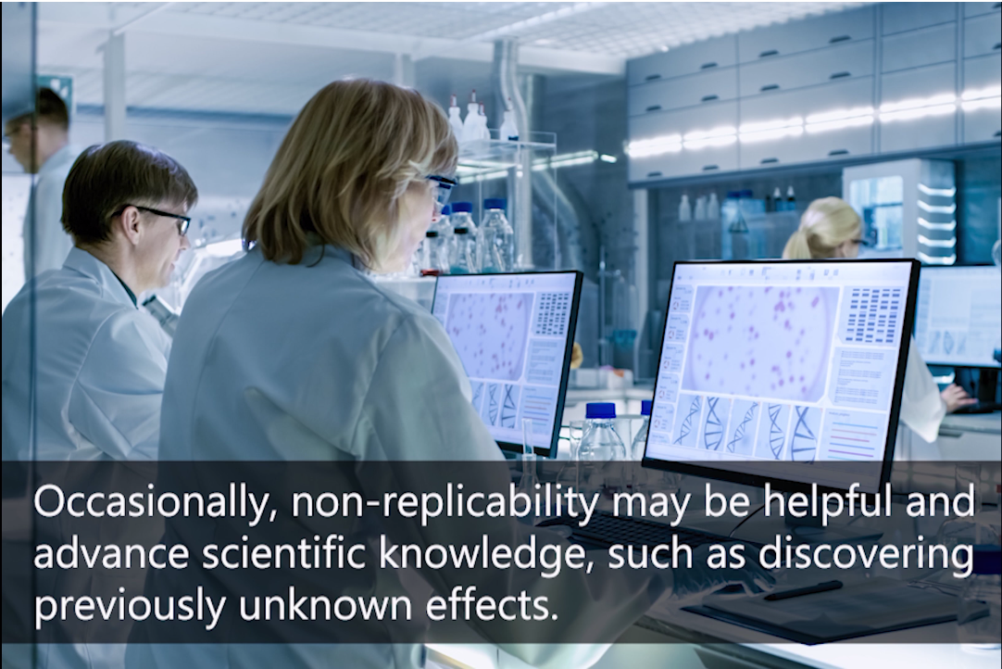
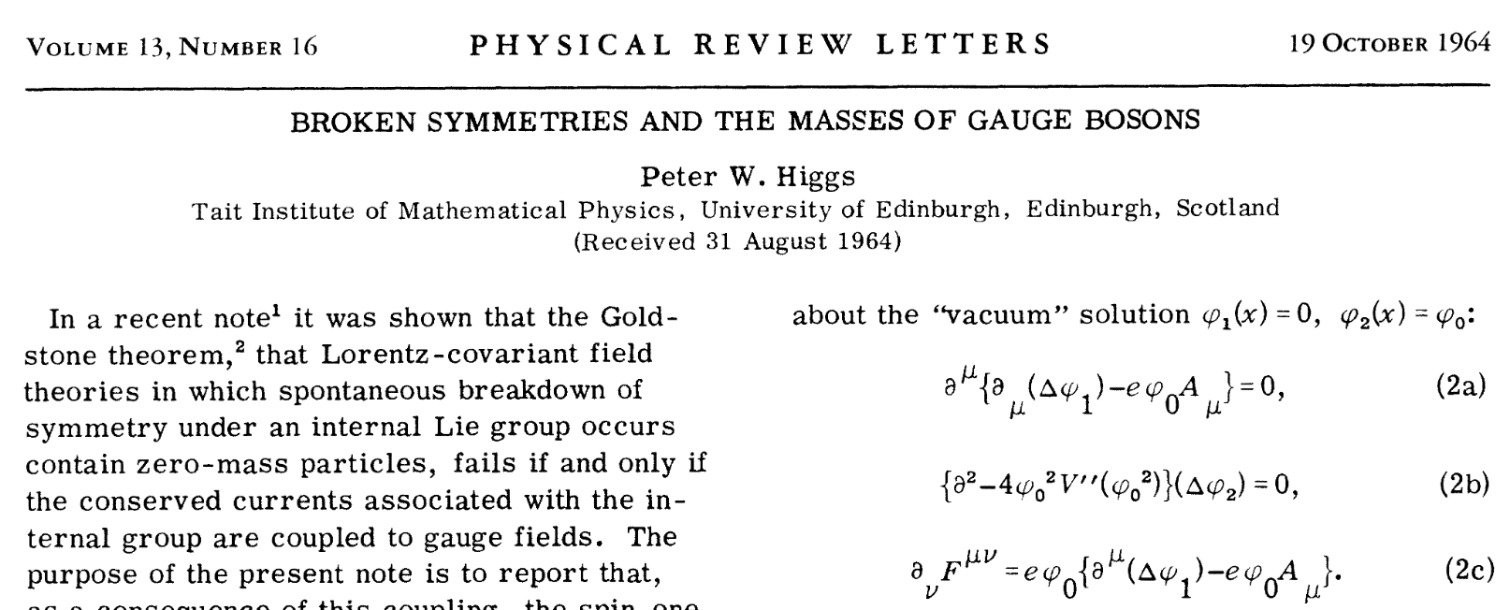
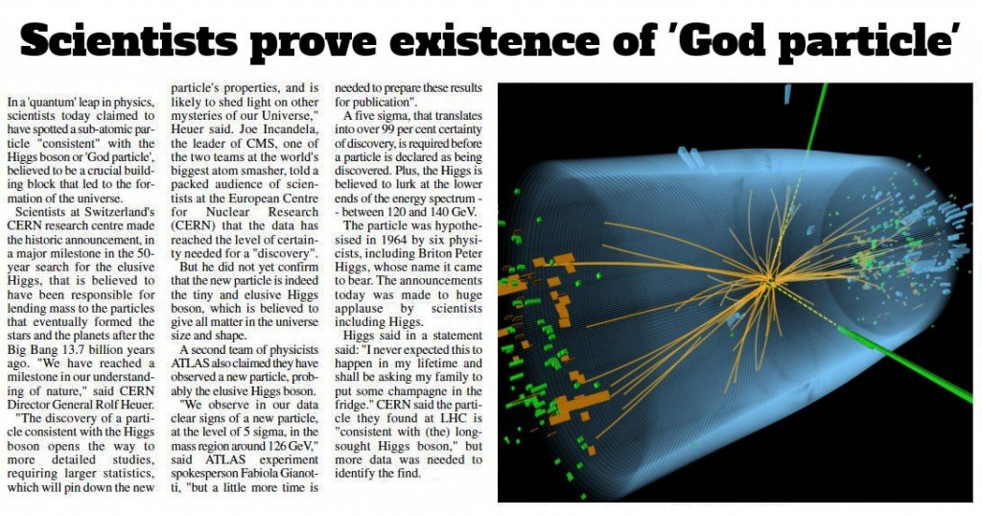

Reproducibility and Replicability in Data Science
1964
2012
https://www.scienceabc.com/nature/universe/why-is-higgs-boson-called-the-god-particle.html

Slide 17

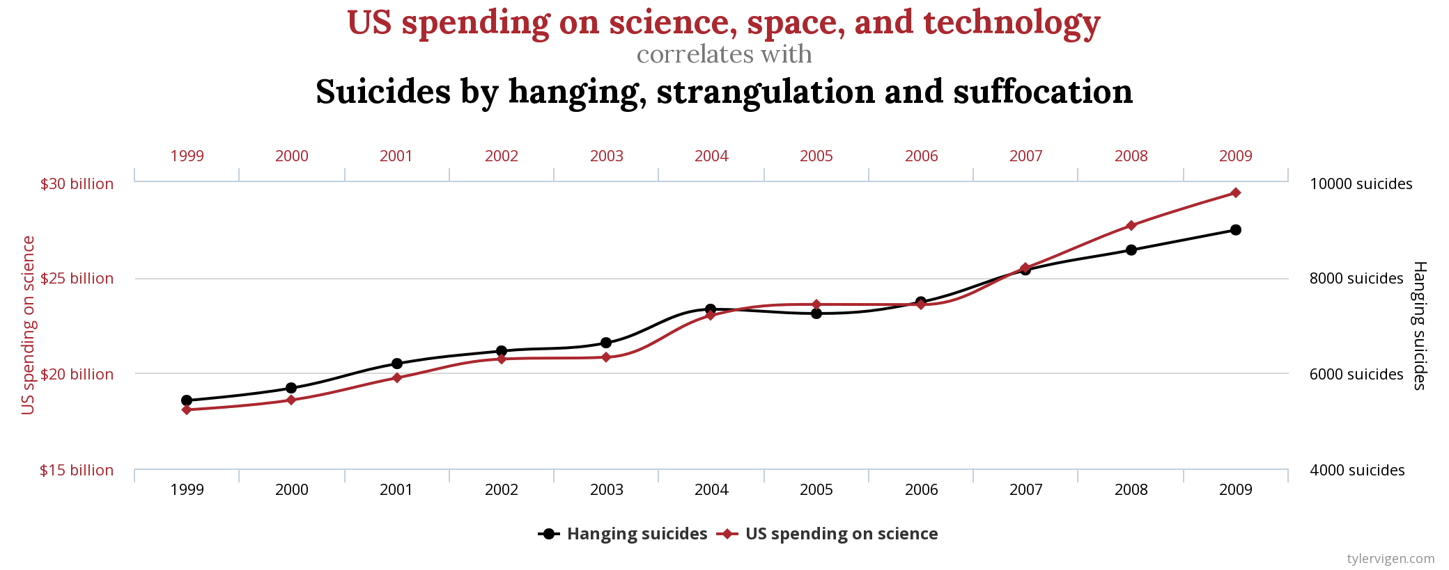
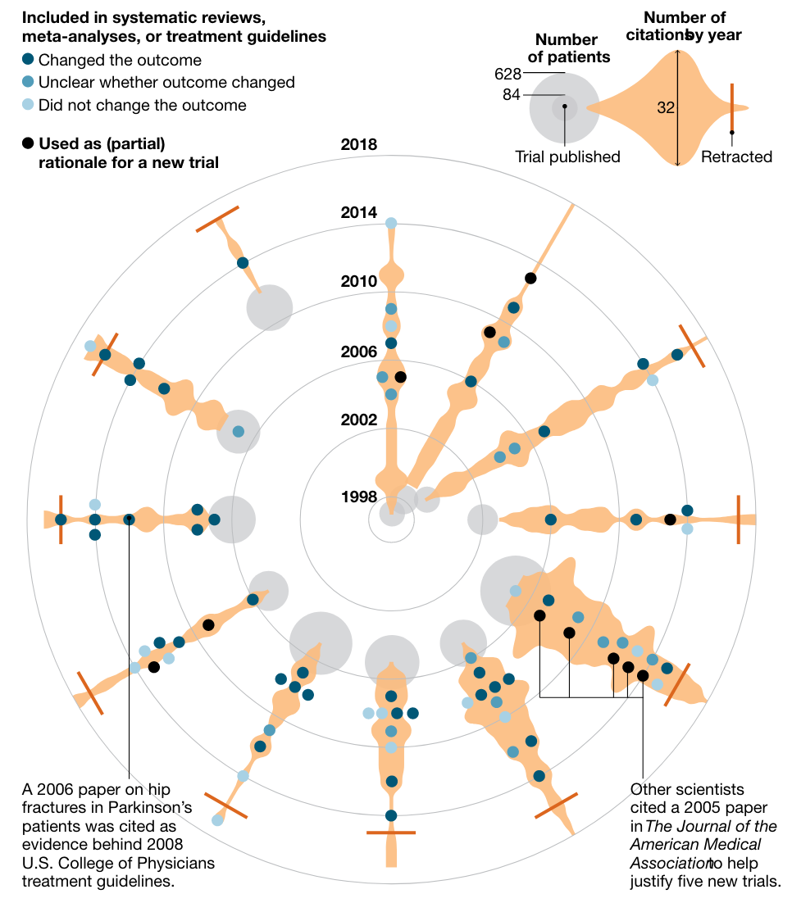

Reproducibility and Replicability in Data Science
PUBLISH OR PERISH !

Slide 18
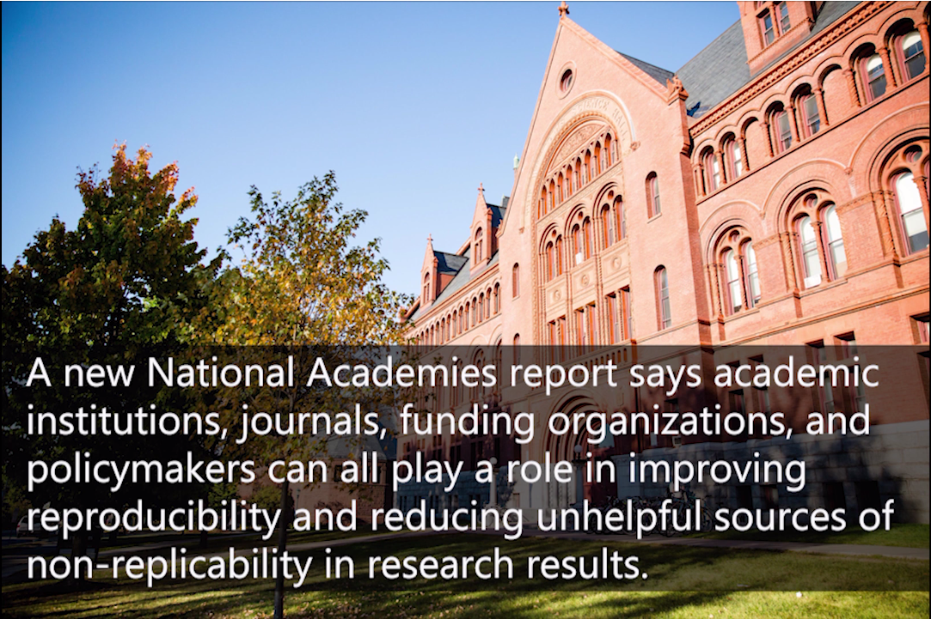

Reproducibility and Replicability in Data Science

Slide 19
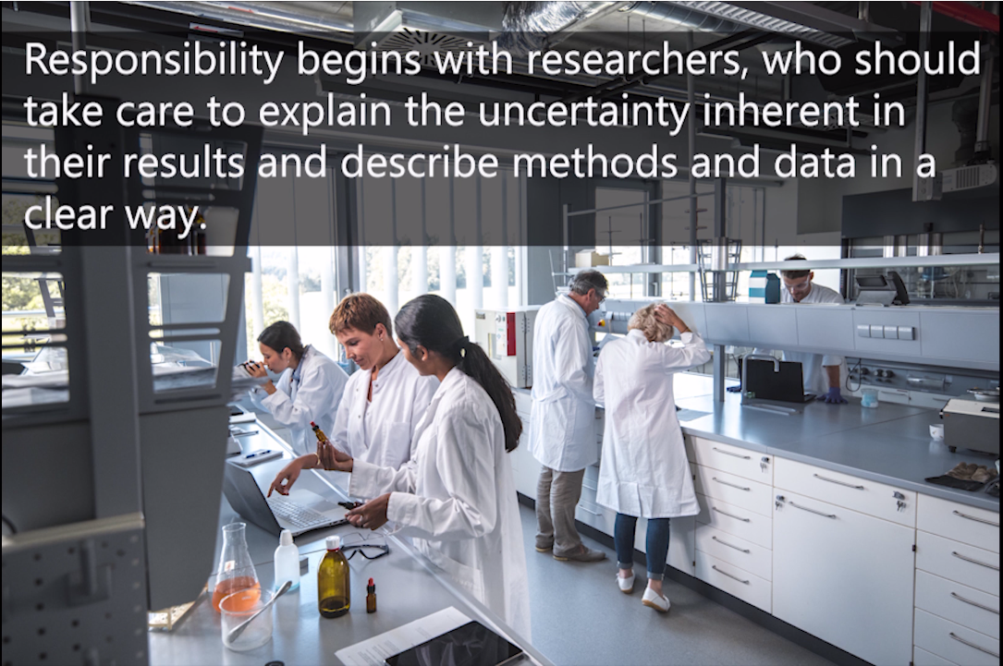


Reproducibility and Replicability in Data Science

Slide 20
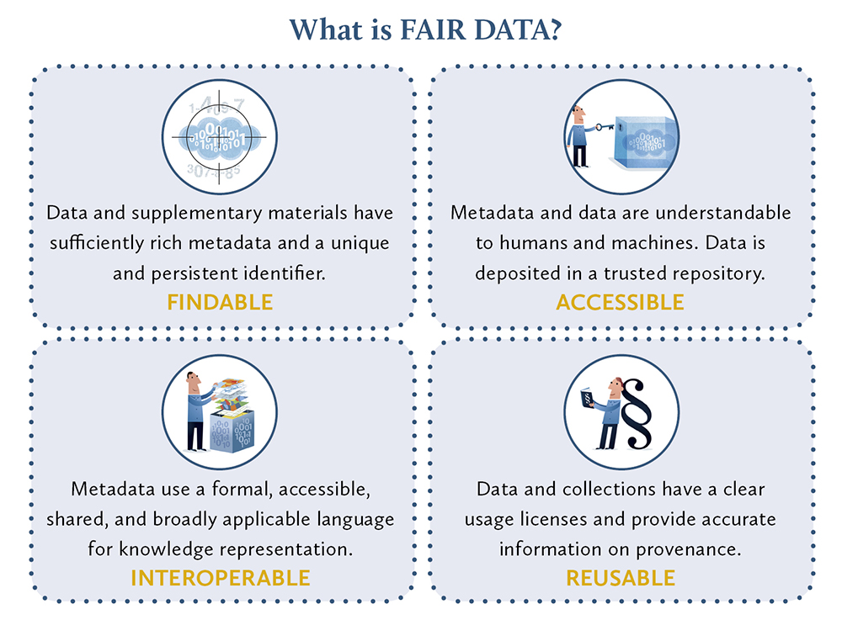
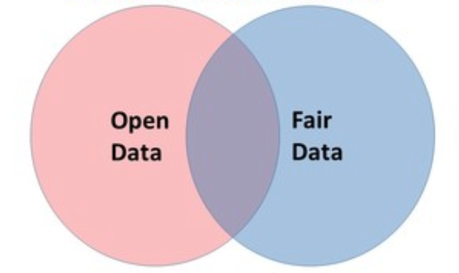
Open Science ≠ Open Data
Source: LIBER

Slide 21
Five FAQs in Data-Driven Research

Slide 22
1. How did I compute this result?

Slide 23
2. How does new data change this result?

Slide 24
3. How did you compute your result?
Can I use your data to reproduce it?
With your code?
On your infrastructure?

Slide 25
4. Has anyone ever used an <XYZ-algorithm>
On this data?
Did it work?

Slide 26
5. Who is using the data and algorithms?
In which context?

Slide 27
Five Questions —> Three Words
Reproducibility
Reusability
Collaboration

Slide 28
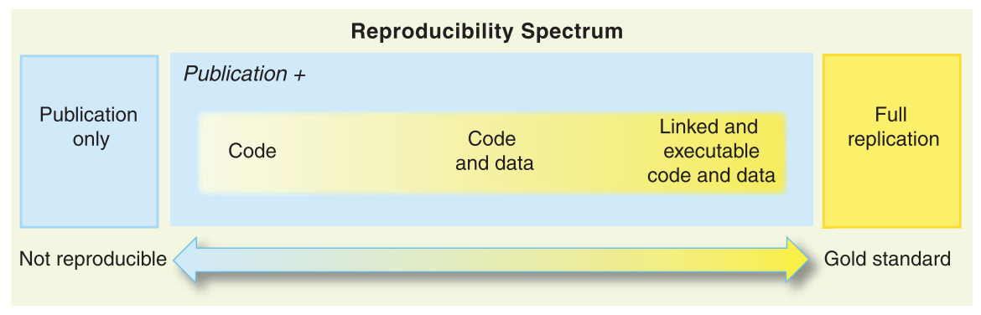
Reproducibility Spectrum
Source: Peng, 2011

Slide 29










Reproducibility Spectrum
Source: Peng, 2011

Slide 30

A Myriad of Tools
A Myriad of Tools
Hard work to make science reproducible, accessible, open etc…
Version control (git)
Code sharing (GitHub, GitLab, BitBucket)
Data sharing (Zenodo, Figshare, institutional digital archives)
Presentation and communication (Jupyter, RStudio)
Correctness – testing (CI, e.g. Travis CI)
Packaging, containerization (Docker, singularity)
Difficult to stay productive and worry about all of the above!

Slide 31

Reproducibility Spectrum
Source: Peng, 2011

Slide 32
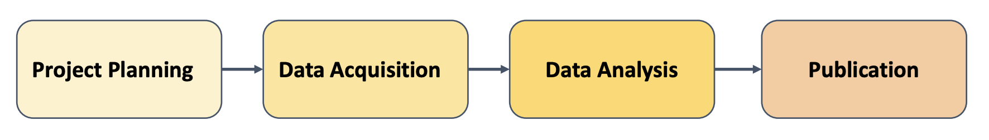
Data Lifecycle: “data” + code + environment
git, GitHub
Docker
Binder
Under VC?
Data Sharing and preservation:
Zenodo, Dataverse
Code Ocean
Reproducibility, Reusability, Collaboration
Notes:
Data Roadmap, based on Briney, 2015

Slide 33


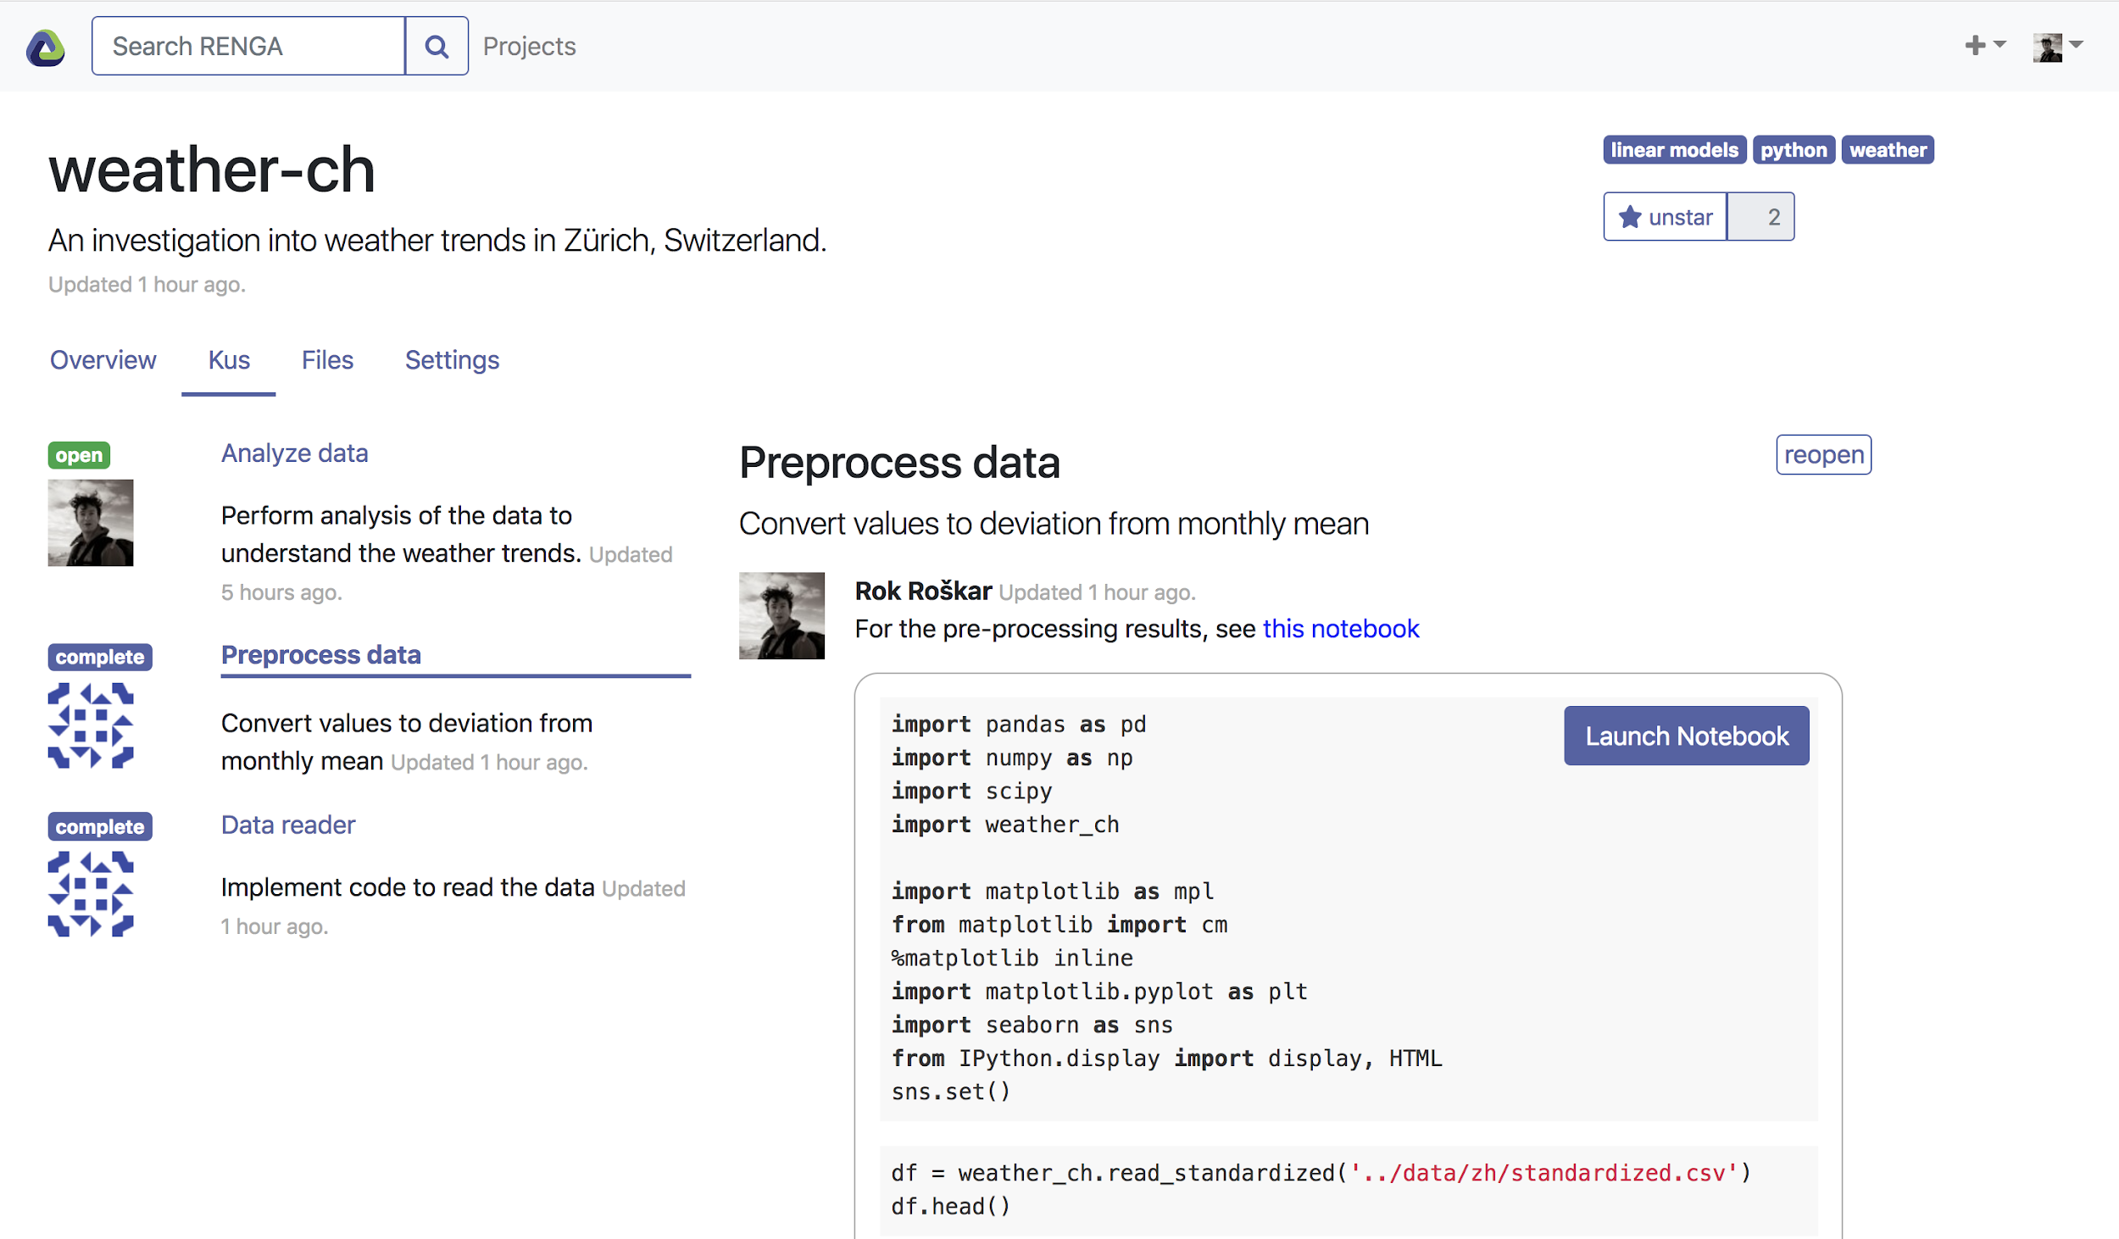

RENKU - 連句 - A platform for reproducible (data) science
Jupyter Notebook
RENKU
Reproducibility
Reuse
Collaboration
RStudio
Gitlab
RDF
MATLAB
local
Docker
Keycloak
JupyterLab
…
Kubernetes
On premise,
Or on the cloud

Slide 34



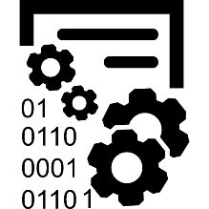



Encapsulate with rich metadata
Encapsulate with rich metadata
Metadata use Dublin Core, FOAF, and Schema.org
Provenance graph is based on PROV-O W3C recommendation
CWL for representing all computational steps
Capture individual steps from user input
Tools for constructing workflows from basic pieces
Rely on container technologies to ensure reproducibility
used
derived
from
used
derived from
Notes:
building on existing ontology
researchobject.org

Slide 35
Best-practices translate to immediate benefits
• Better productivity (less time spent remembering how something is done)
• Better visibility and impact within the organization
• Better public visibility - willingness to open and share methods boosts trust

Slide 36

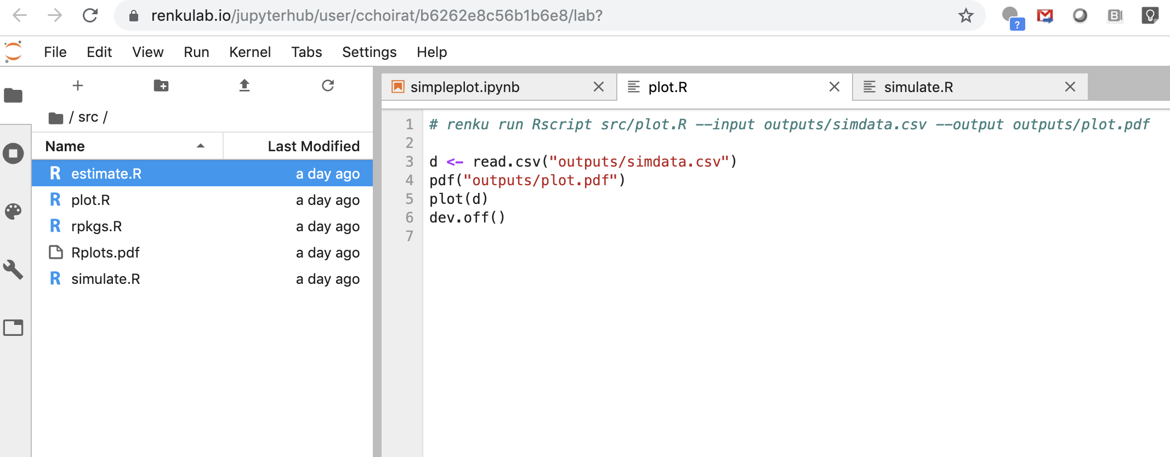

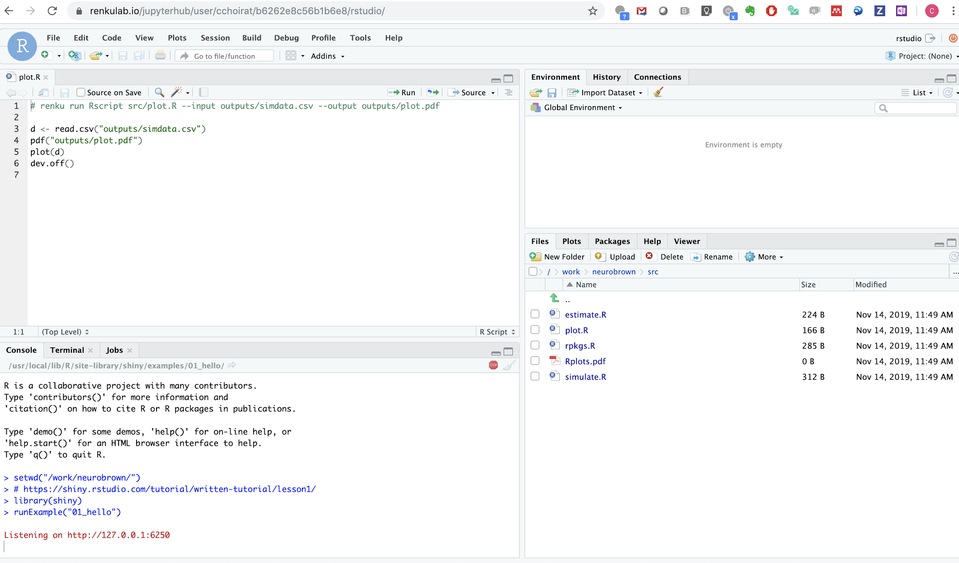





What is Renku, really?
What is Renku, Really?
A platform integrating:
git, Jupyter/RStudio, docker, analysis workflows linked with a knowledge graph

Slide 37
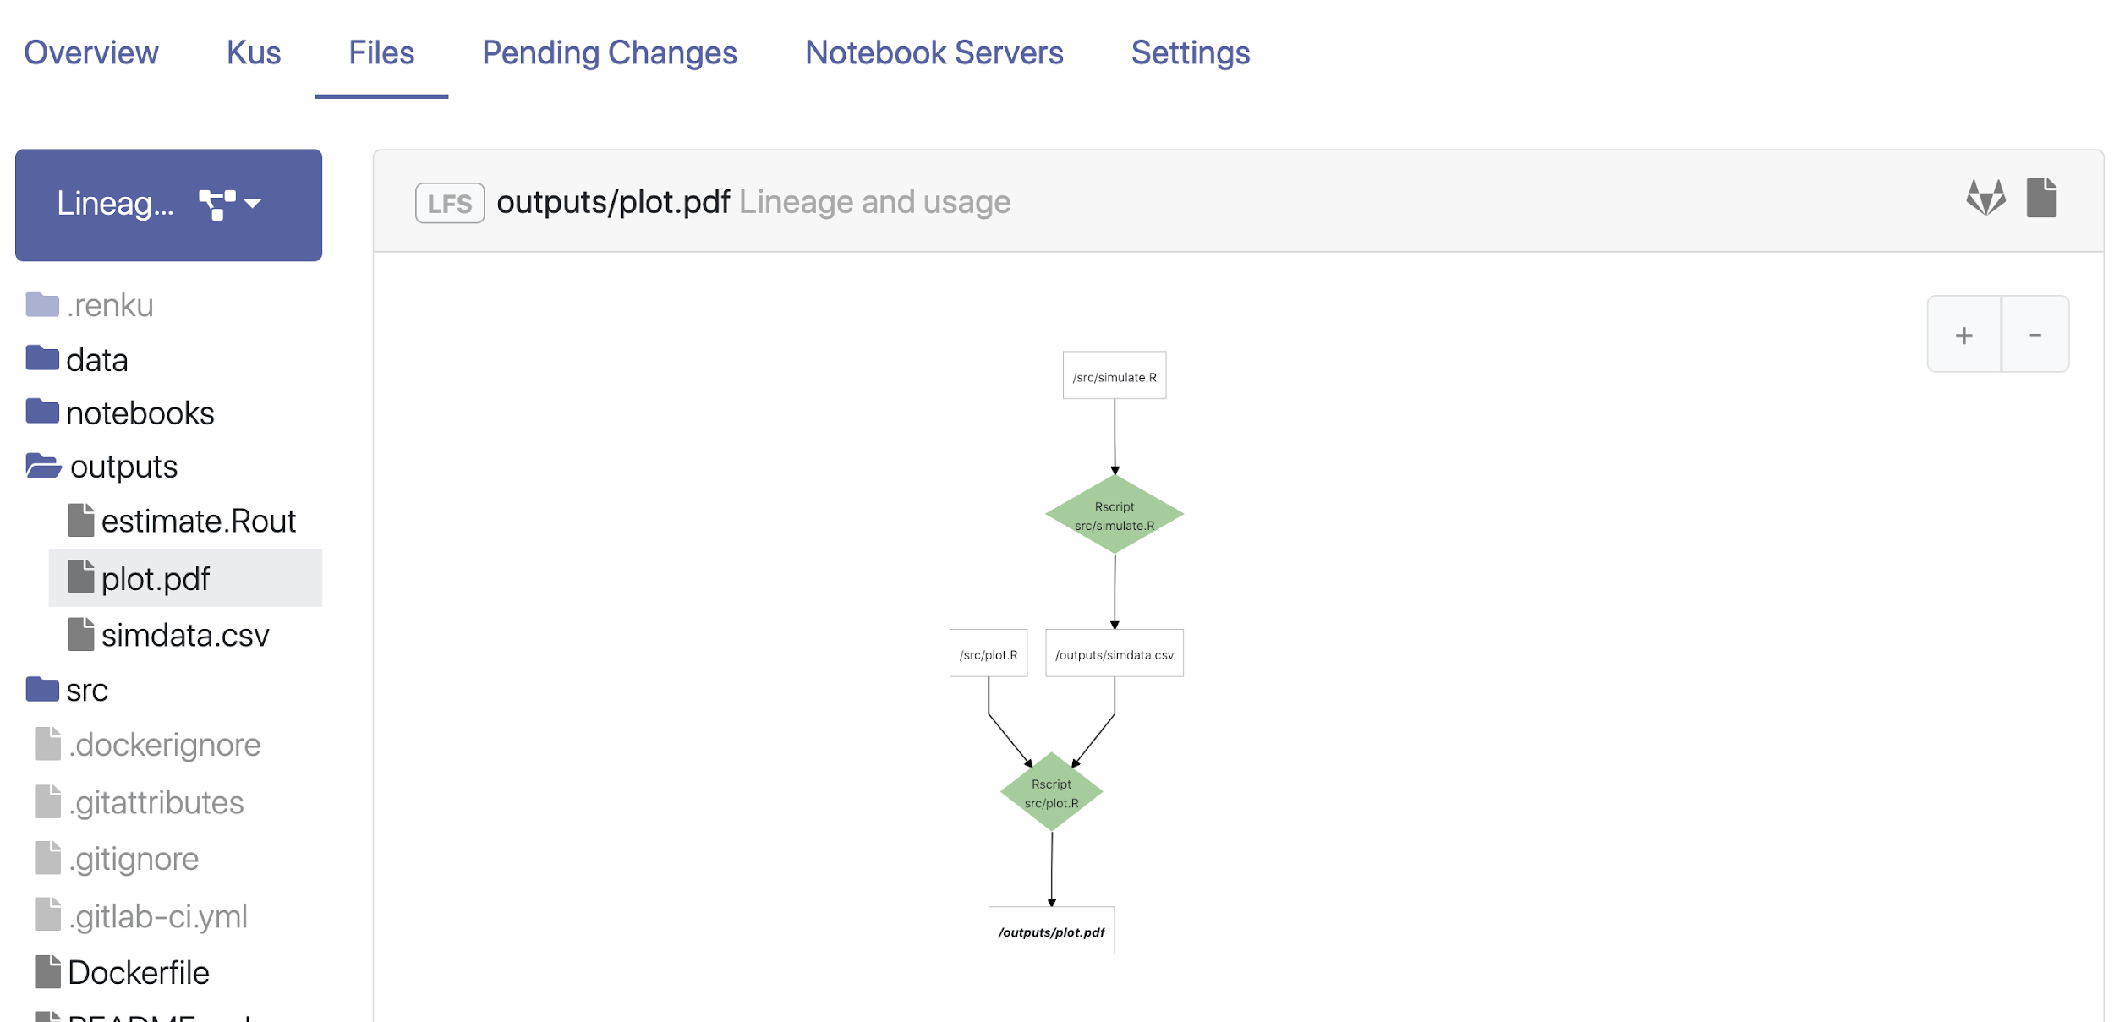
What is Renku, really?
What is Renku, Really?
A platform integrating:
git, Jupyter/RStudio, docker, analysis workflows linked with a knowledge graph

Slide 38
Data Science Tools for Collaboration
Spring 2020 - week #2

Slide 39
Reproducibility
Reusability
Collaboration

Slide 40
Reproducibility
awk –F, ‘{ a[$1]++} END { for(i in a) { print i,a[i] } } <(find . –name \*.\*sv –exec cat \{\} \;) | sort –k2,2 –n -r
Input data
+ Code
+ Computational Steps
+ Runtime Environment
(All must be versioned)
Code
Computational steps
Data
Process
Result
Environment (libraries, ...)
Operating System
Hardware

Slide 41
Reproducibility
awk –F, ‘{ a[$1]++} END { for(i in a) { print i,a[i] } } <(find . –name \*.\*sv –exec cat \{\} \;) | sort –k2,2 –n -r
Input data
+ Code
+ Computational Steps
+ Runtime Environment
(All must be versioned)
Hint: keep data and computational steps in separate projects => promote reusability
Code
Computational steps
Data
Process
Result
Environment (libraries, ...)
Operating System
Hardware

Slide 42
Reusability
Same data with new computational steps & code
or
Same computational steps & code with new data
Enables Collaboration

Slide 43
Collaboration Tools
Share code and workflows
versioning: git, svn, mercurial, ...
services on the cloud: gitlab, github, bitbucket, ...
Share data
as working datasets git lfs
as open datasets: Zenodo, or others that gives you a DOI
Share run time
Docker containers or VMS (virtual box, vmware)

Slide 44
Git
Linus Torvalds, 2005
ref: https://git-scm.com/docs
Basic commands: clone, status, add, rm, mv, commit, pull, push
Useful commands: log, merge, stash, checkout, branch, diff, tag
Advanced commands: cherry-pick, rebase, remote, init, revert, reset
Commits represents snapshots of the state of the repository, expressed as a diff from the previous one
Notes:
Interactive tutorials for beginners : https://try.github.io, https://swcarpentry.github.io/git-novice/
Git aliases ???
Gitflow workflow: https://www.atlassian.com/git/tutorials/comparing-workflows/gitflow-workflow
Complete git book: https://git-scm.com/book/en/v2

Slide 45
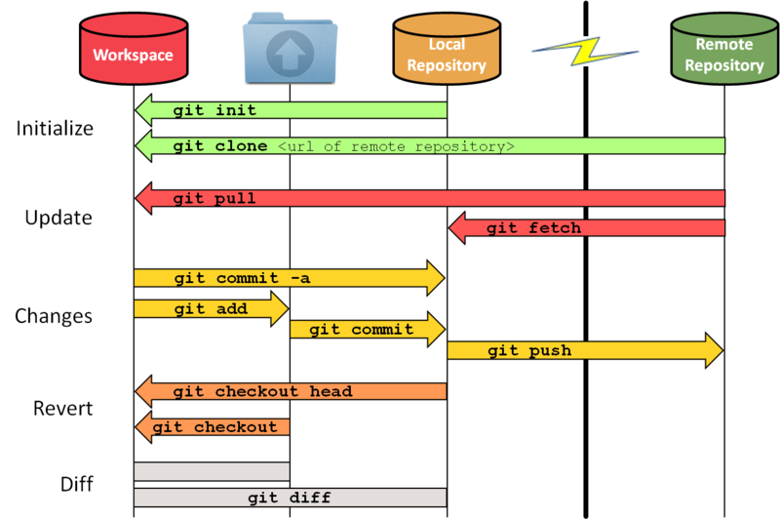
Git
Notes:
https://git-man-page-generator.lokaltog.net/

Slide 46
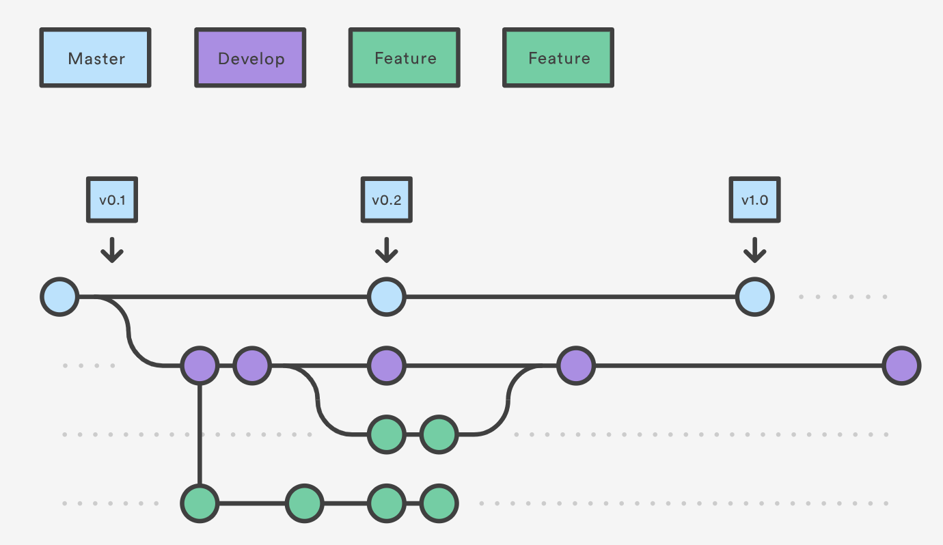
Git: branches
Commits form a tree (+ merges), with branches
git branch name, then git checkout name to switch between branch names or commit
git push origin name (push a branch)
git merge origin/name (merge the tip of a branch on current branch)
git log --graph --pretty=oneline --abbrev-commit --all (display the commit graph)
Gitflow: good practice for branching, “decentralized but centralized”
Notes:
Interactive tutorials for beginners : https://try.github.io, https://swcarpentry.github.io/git-novice/
Git aliases ???
Gitflow workflow: https://www.atlassian.com/git/tutorials/comparing-workflows/gitflow-workflow
Complete git book: https://git-scm.com/book/en/v2
Image source: https://www.atlassian.com/git/tutorials/comparing-workflows/gitflow-workflow, https://nvie.com/posts/a-successful-git-branching-model/
https://git-scm.com/book/en/v2/Git-Branching-Branches-in-a-Nutshell

Slide 47
Git LFS
Used to work with big files
Replace large files in your repository with tiny (versioned) pointer files
Pointer files are swapped out for the real files at checkout (using smudge and clean)
Basic commands: git lfs track, git lfs ls-files, git lfs fetch
More advanced command: git lfs migrate – convert history of git repository to use Git LFS (when large files are accidentally committed)
Most common mistakes:
You believe you are reading the real file, but it is a pointer file (e.g. git lfs fetch is turned off)
You have an existing file, track it with git lfs and replace it with a tiny pointer file when you commit, but you forget to remove the large file from the git history with git lfs migrate
Refs
https://git-lfs.github.com
https://github.com/git-lfs/git-lfs/wiki/Tutorial

Slide 48
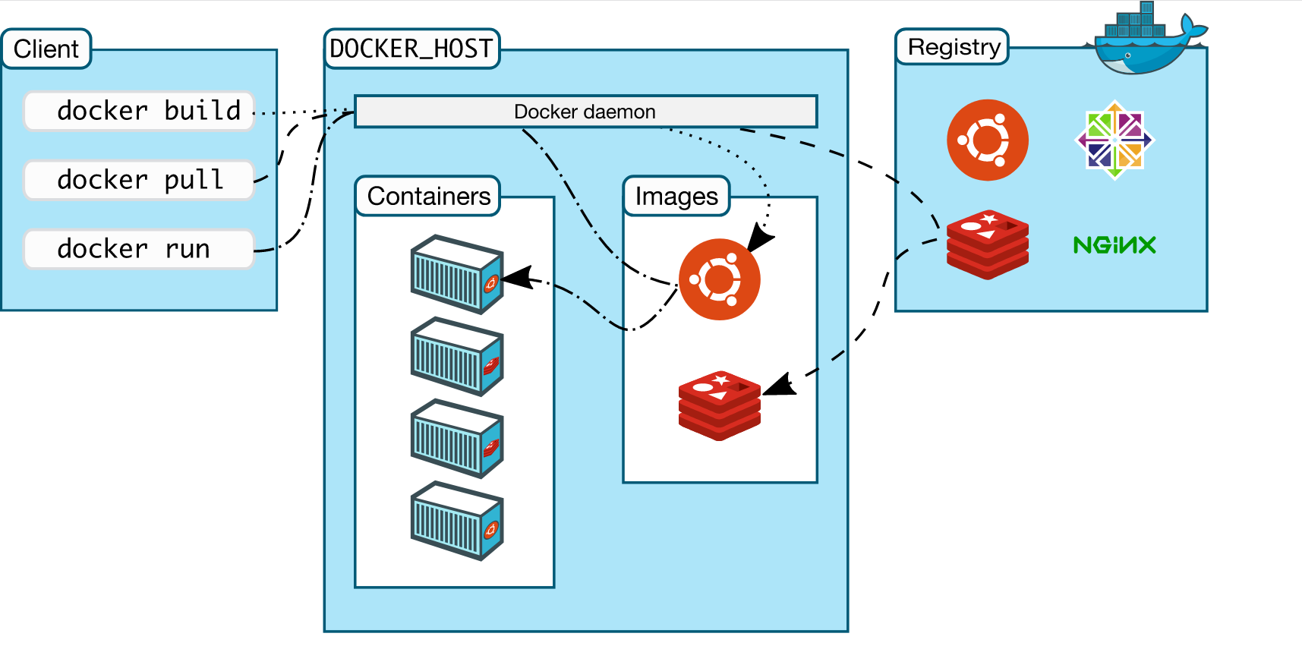
Docker
https://docs.docker.com/

Slide 49
Docker image vs. Docker container
Docker image:
a stack of read-only layers (a file)
packaged and tagged (downloadable from a registry)
docker pull / docker build
docker images
Docker container
instance of a docker image with a writable layer (volume)
has an id and a name
docker run / docker create
docker ps -a

Slide 50
Building Docker images from Dockerfile
FROM debian:stable
Base image, have a look at https://hub.docker.com/explore/
USER root
Set the user for the following commands
RUN apt-get update && apt-get install -y --force-yes apache2
Run arbitrary shell commands, each line add a overlay layer!
EXPOSE 80 443
Defines the network ports that will be exposed
COPY website.conf /etc/apache2/site-enabled/
Put a copy of a local file into the docker image, it also add a new layer.
VOLUME ["/var/www", "/var/log/apache2"]
Specifies mountpoint for external volumes
ENTRYPOINT ["/usr/sbin/apache2ctl", "-D", "FOREGROUND"]
The command that is run when container starts
https://docs.docker.com/develop/develop-images/dockerfile_best-practices/
Notes:
https://docs.docker.com/develop/develop-images/dockerfile_best-practices/

Slide 51
Managing containers
docker run / docker attach / docker exec -ti
for attaching stdin/stdout to a new/runnning container
docker start / docker stop
for starting/stopping existing containers
docker kill / docker rm
for force-quit and cleanup the volume

Slide 52
Exercises Week 2
Spring 2020 - week #2

Slide 53
Start your engines
Head over to the RENKU webpage
https://renku.iccluster.epfl.ch
You will need the EPFL VPN if connecting from outside the EPFL network
Find and fork project dslab2020/dslab-exercises-week-2
Follow the instructions from the README
Notes:
conda --version
conda update conda
conda info --envs or conda env list
conda create --name DSLab2019 python=3.7
conda activate DSLab2019
conda info --envs
python --version
conda search jupyter
conda install jupyter
conda list
conda search scikit-learn
# conda install scikit-learn=0.20.2=py37hebd9d1a_0
# conda list
conda deactivate
conda env remove -n DSLab2019

Slide 54
Thank you!

